Slide 1

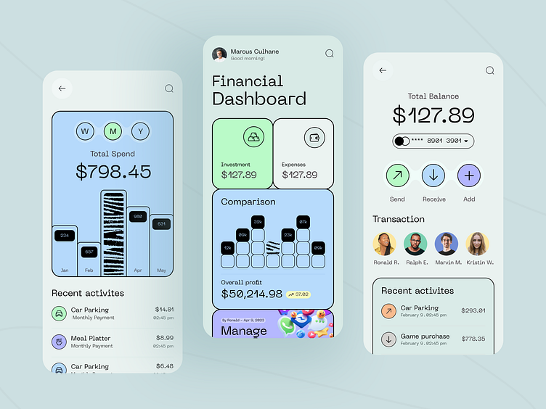
PROJECT • FINTECH + AI
FINWISE AI
AI-Powered Financial Decision &
Financial Health Companion
A simple decision-support platform that turns personal financial inputs into understandable scenarios and explanations.
“See the impact before you commit.”

Slide 2




•
STUDENT PROJECT PRESENTATION
MCA 1st Year / KIET
TEAM
FinWise AI: AI-Powered Financial Decision & Financial Health Companion
CORTEX
PROJECT TEAM MEMBERS
5 Members
PROJECT GUIDANCE & MENTORSHIP
TEAM LEADER
Utkarsh Jain
2628MCA0128
Mr. Sunder Rajini Sir
TEAM MEMBER 1
Faculty Mentor • Department of Master of Computer Applications (MCA)
Vidushi Bhatt
2628MCA0020
TEAM MEMBER 2
2628MCA0194
Uttam Kumar
TEAM LEADER 3
INSTITUTION DETAILS
Utkarsh Singhal
2628MCA0143
KIET Group of Institutions
TEAM LEADER 4
DOMAIN & SPECIALIZATION
Vikas Jain
2628MCA0311
Branch: MCA 1st Year
FinTech, Financial Literacy & Applied AI Systems
Department of Computer Applications • KIET • Team Cortex
Next: Project Overview & Architecture →

Slide 3



01 | PROJECT OVERVIEW
FinWise AI — AI-Powered Financial Decision & Financial Health Companion
FINWISE AI | 01
1
UNDERSTAND
2
SIMULATE
3
DECIDE
Read income, expenses, commitments and goals in one view.
Test purchases, subscriptions, EMIs and other choices.
Compare scenarios; the user keeps the final decision.
FINANCIAL DECISION FLOW
FINWISE AI MOCKUP
ACTIVE DEMO
FINANCIAL DATA
FREE CASH FLOW
GOAL HEALTH
Income • Expenses • Commitments • Goals
₹18.4k
74%
BUY NOW
DELAY
ALT.
ANALYSIS
Cash flow • Savings • Affordability • Goals
AI INSIGHT
Possible impact: next-month savings capacity may decrease.
AI EXPLANATION
Simple observations and scenario comparison

Slide 4

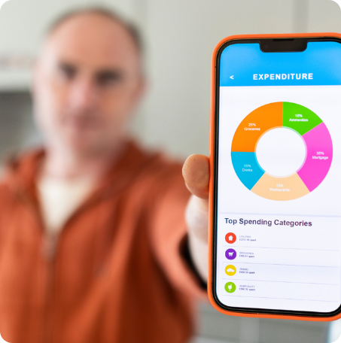
02 | PROBLEM
Understanding the Financial Impact of Everyday Decisions
FINWISE AI | 02
CORE CHALLENGE
Users need one place to connect today’s choice with future cash flow and goals.
“Is this decision affordable after considering everything else?”
FINWISE AI BRINGS THE PIECES TOGETHER
01
Fragmented Information
Income, expenses, EMIs, subscriptions and goals are often tracked separately.
02
Hidden Future Impact
A purchase can change future cash flow even when it looks affordable today.
03
Difficult Comparisons
Users may need to compare buy now, delay, alternatives or EMI.
04
Financial Uncertainty
The effect on savings and goals is not always easy to estimate.
05
Complex Financial Language
Calculations can be difficult to interpret quickly.

Slide 5
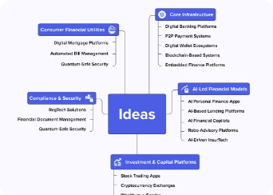
03 | SOLUTION APPROACH
From Financial Problem → Possible Solutions
FINWISE AI | 03
SELECTED CONCEPT
POSSIBLE SOLUTIONS
PRIORITIZATION CRITERIA
FINWISE AI
IMPACT
01 Financial Health Dashboard
Improves financial understanding
A unified financial decision-support companion combining:
FEASIBILITY
Realistic to implement
02 Expense & Commitment Tracker
USEFULNESS
Financial Data
Relevant for repeated use
03 Purchase Impact Simulator
CLARITY
Easy to explain
Scenario Simulation
SCALABILITY
04 Scenario Comparison Engine
Supports more scenarios
Comparison
05 AI Financial Explanation Assistant
AI Explanation
Problem → Ideas → Prioritization → FinWise AI

Slide 6
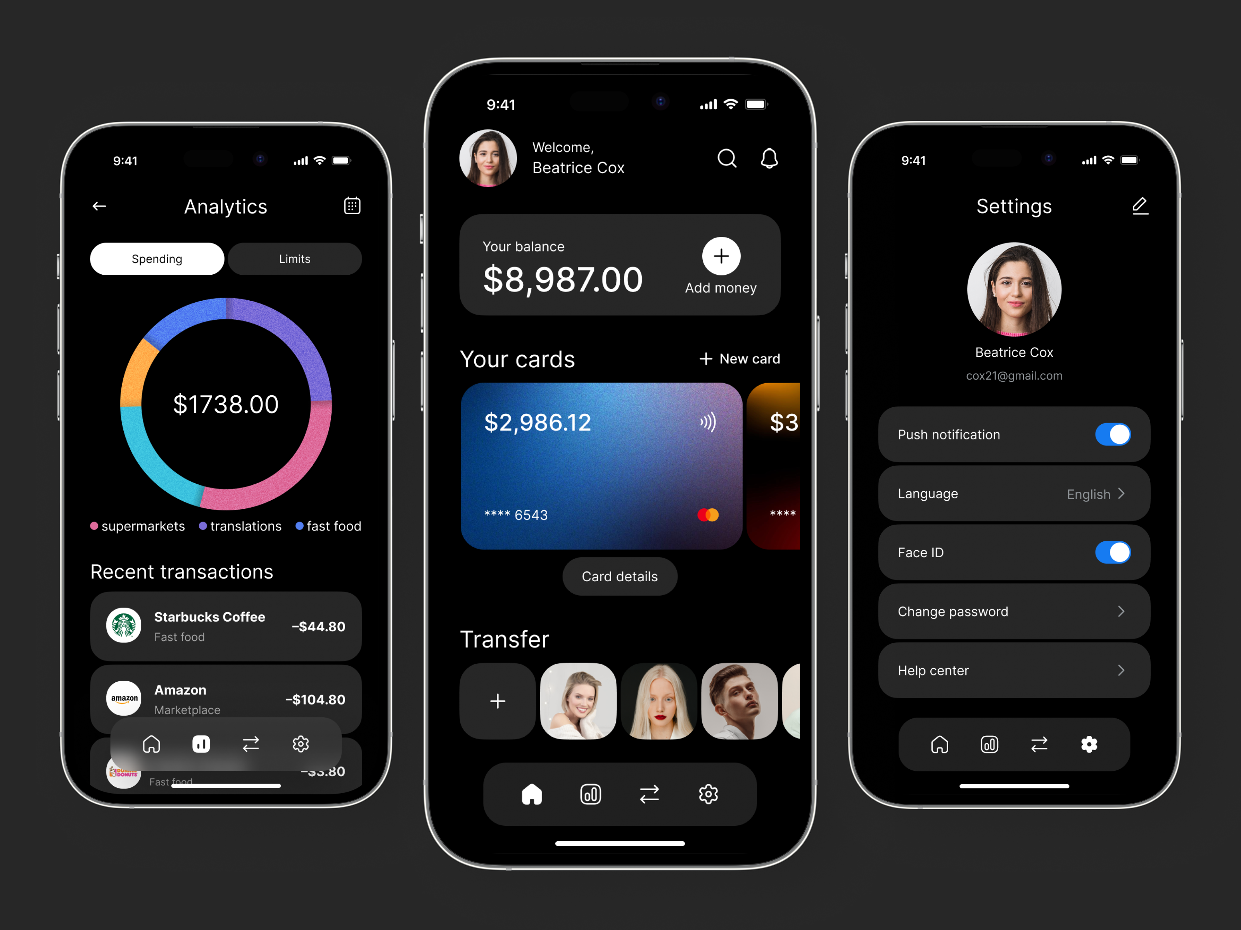
04 | USER JOURNEY
From Financial Data to an Informed Decision
FINWISE AI | 04
SIMPLE 6 - STEP FLOW
01
02
03
04
05
06
INPUT
ADD DECISION
ANALYZE
SIMULATE
COMPARE
UNDERSTAND
Income • Expenses
Commitments • Goals
Purchase • Subscription
EMI • Commitment
Cash flow • Savings
Affordability • Goals
Buy now • Delay
Alternative • EMI
View scenario
outcomes side-by-side
AI explains the
potential implications
NEXT →
NEXT →
NEXT →
NEXT →
NEXT →
OUTPUT ✓
CORE PRINCIPLE
USER REMAINS THE FINAL DECISION - MAKER
FinWise AI supports understanding and comparison; it does not make the final choice.
POSITIONING: Decision support • financial insight • AI-generated explanation

Slide 7
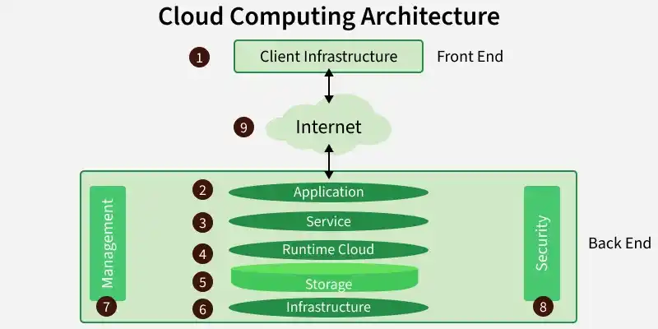
05 | SYSTEM DESIGN
How FinWise AI Works
FINWISE AI | 05
ARCHITECTURE
TECHNOLOGY STACK
USER LAYER
Student / Young Professional
FRONTEND
React / HTML / CSS / JS
BACKEND / LOGIC
Python
INPUT LAYER
Income • Expenses • Commitments • Goals • Proposed Purchase
DATABASE
Database
FINANCIAL ANALYSIS ENGINE
Cash flow • Affordability • EMI • Savings impact • Goal impact
AI LAYER
AI / LLM API
SCENARIO ENGINE
Current • Buy now • Delay • Alternative • EMI
Use only implementation technologies confirmed for the project.
AI EXPLANATION LAYER
Simple explanations • Observations • Comparisons • Risks • Goal impact
OUTPUT
Financial Health Dashboard • Scenario Comparison • AI Explanation

Slide 8
06 | KEY FEATURES
One Platform. Multiple Financial Decisions.
FINWISE AI | 06
FIN01
EMI04
Financial Health Snapshot
EMI & Commitment Analysis
Income, expenses, commitments, savings capacity and goals.
Understand recurring payment obligations and monthly impact.
SIM02
AI05
Purchase Impact Simulator
AI-Powered Explanations
Estimate the possible effect of a proposed purchase.
Turn calculations into clear, understandable language.
CMP03
GOAL06
Scenario Comparison
Goal Impact Analysis
Compare different choices side-by-side.
See how a choice could influence progress toward goals.
TRADITIONAL TOOLS
FINWISE AI
TRACK → RECORD → REPORT
UNDERSTAND → SIMULATE → COMPARE → EXPLAIN → DECIDE
Focus: potential future impact — not just past spending.

Slide 9
FINWISE AI
FINWISE AI | 07
THANK YOU
FINWISE AI DECISION PREVIEW
ACTIVE
AI-Powered Financial Decision & Financial Health Companion
FREE CASH FLOW
GOAL HEALTH
DECISION
₹18.4k
74%
BUY NOW / DELAY
Understand the impact. Explore the possibilities. Make your own decision.
AI Insight: Possible impact: next-month savings capacity may decrease.
TEAM MEMBERS
Department / Institution: MCA / KIET • Team Name: Cortex
Vidushi Bhatt, Utkarsh Jain, Utkarsh Singhal, Uttam Kumar, Vikas Jain

